Slide 1
Novel insights into Vδ1 TCR ɣδ T cells using celiac disease as a model
Toufic
4-2-15

Slide 2
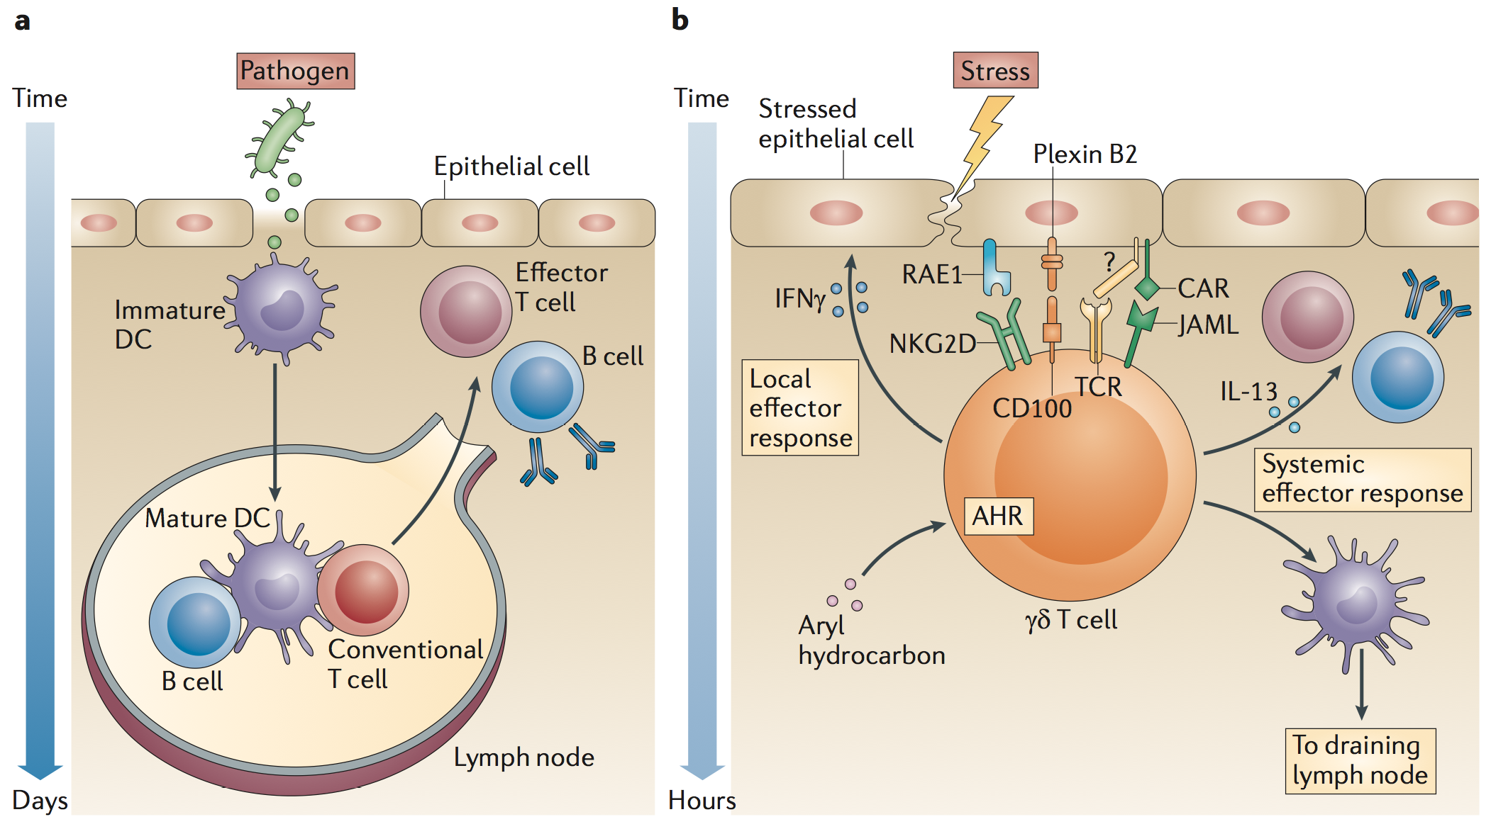
Nature of TCR recognition
First line of defense
Luoma, A et al. Immunity 2013.
Uldrich, P et al. Nat Immunol. 2013.
Vantourout, P and Hayday, A. Nature Rev. Immun. 2013.

Slide 3
Hypothesis
The small intestinal microenvironment uniquely selects the repertoire and functional profile of TCR ɣδ T cells under physiological and pathological conditions

Slide 4
Approach
TCR- Delta Chain
VD1
DN
VD2
Tissue
Blood
Intestine
Disease
Control
GFD
Active

Slide 5
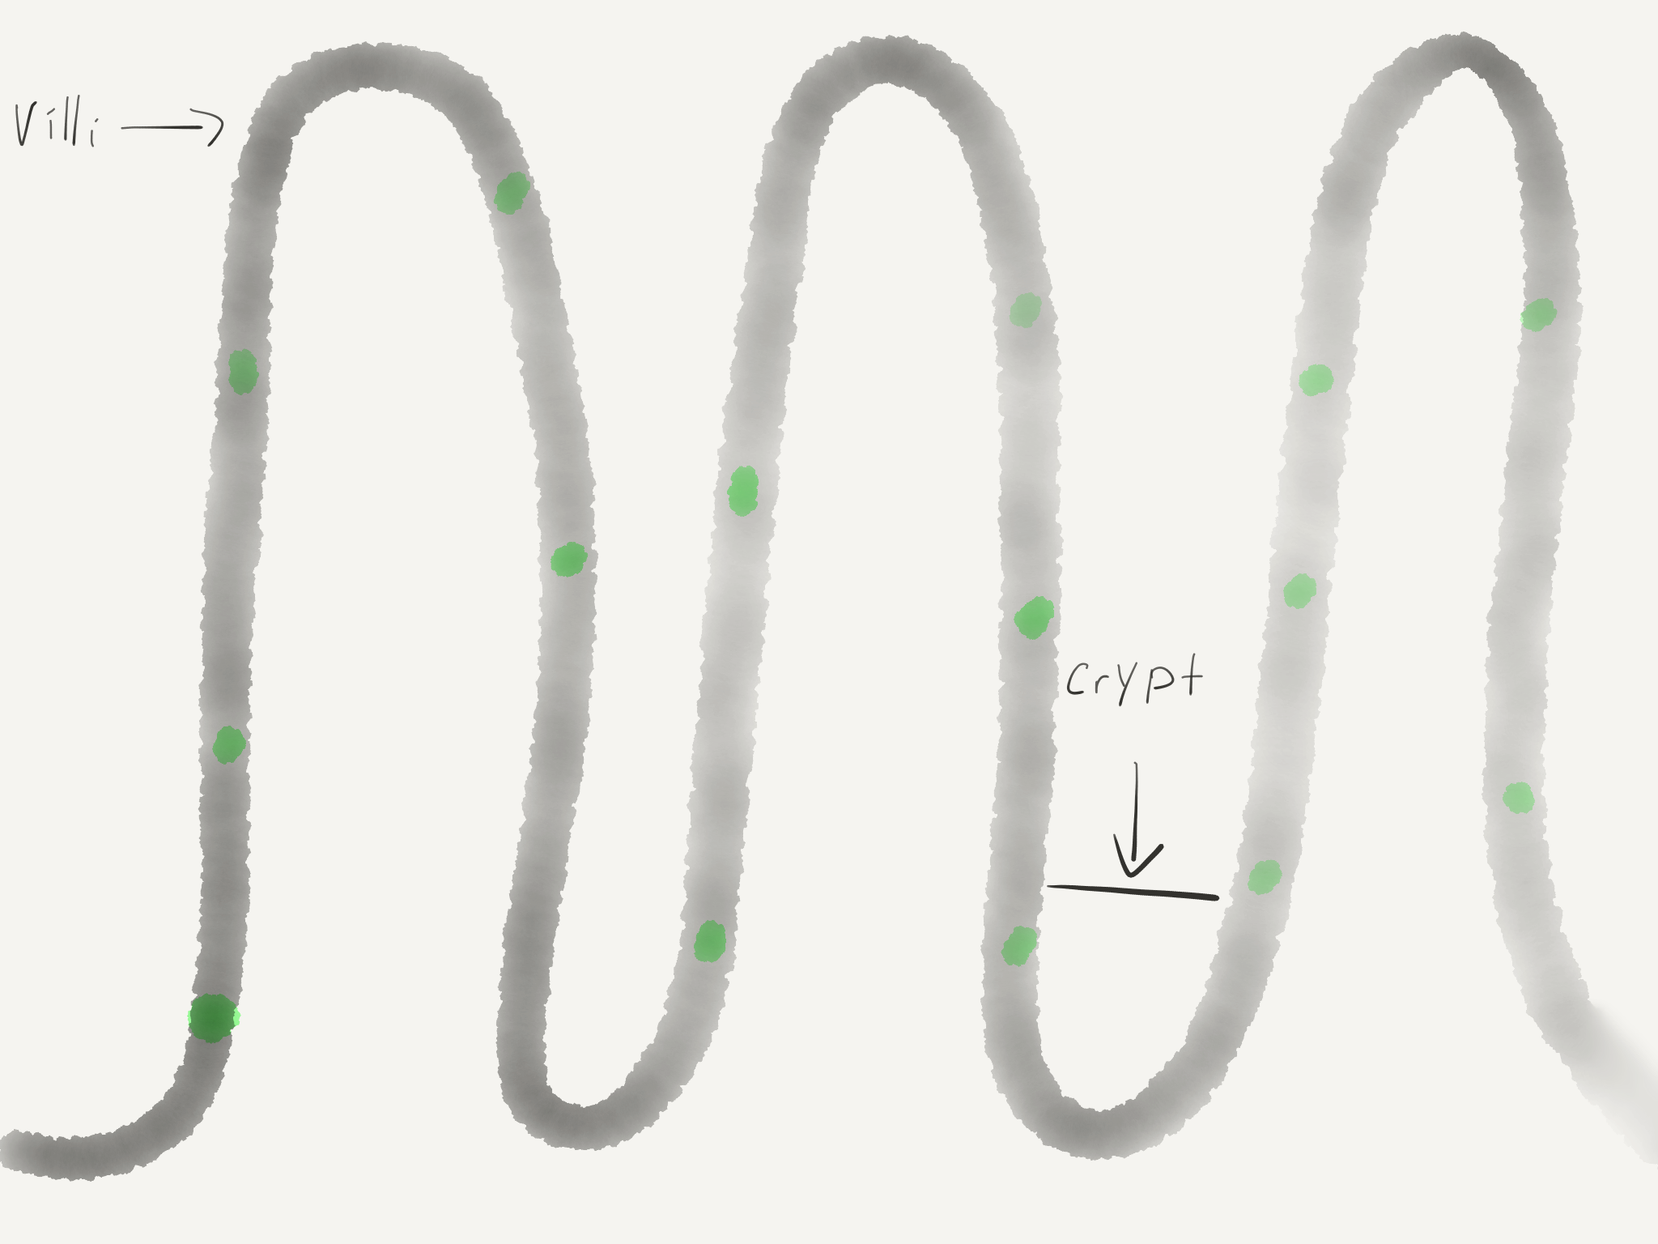
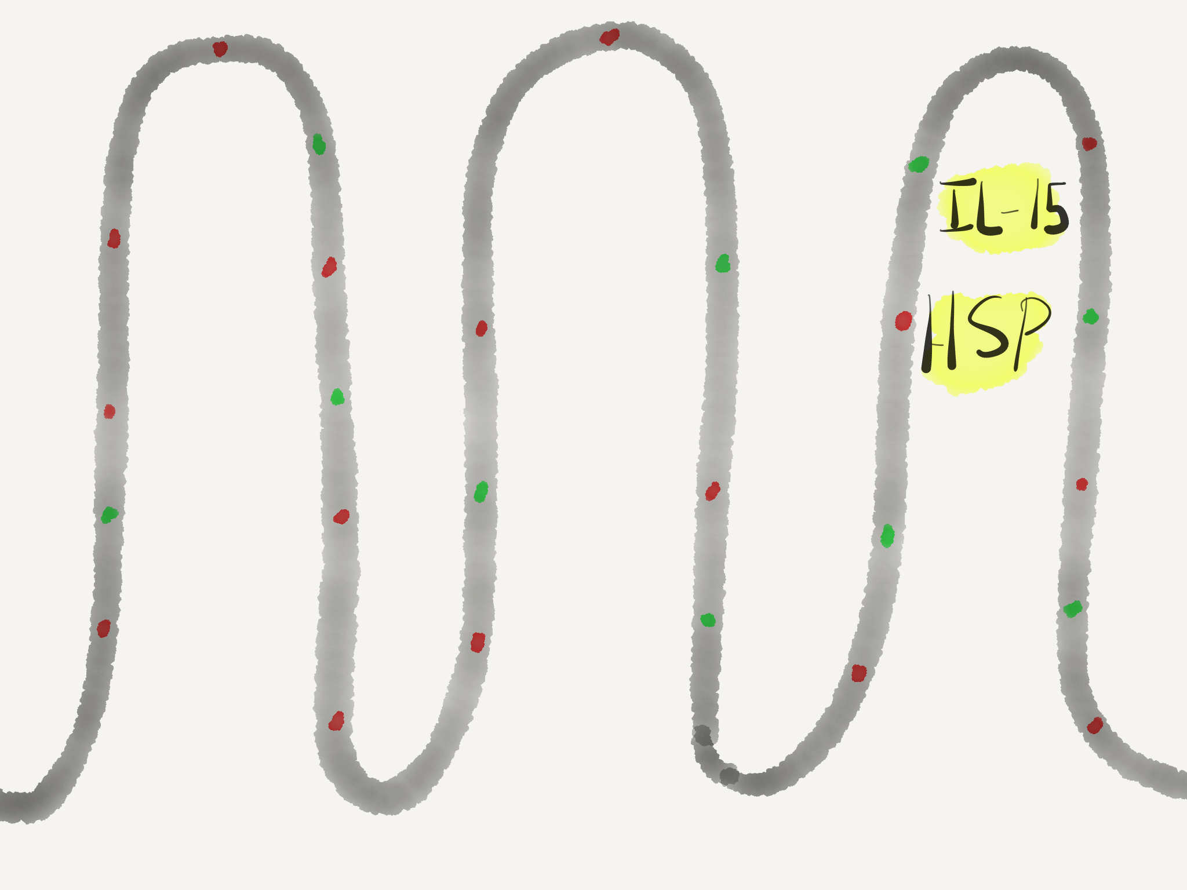
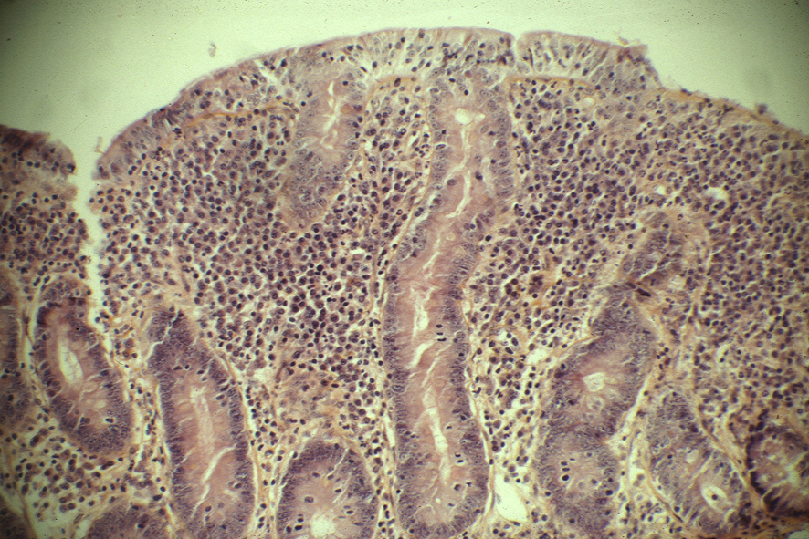
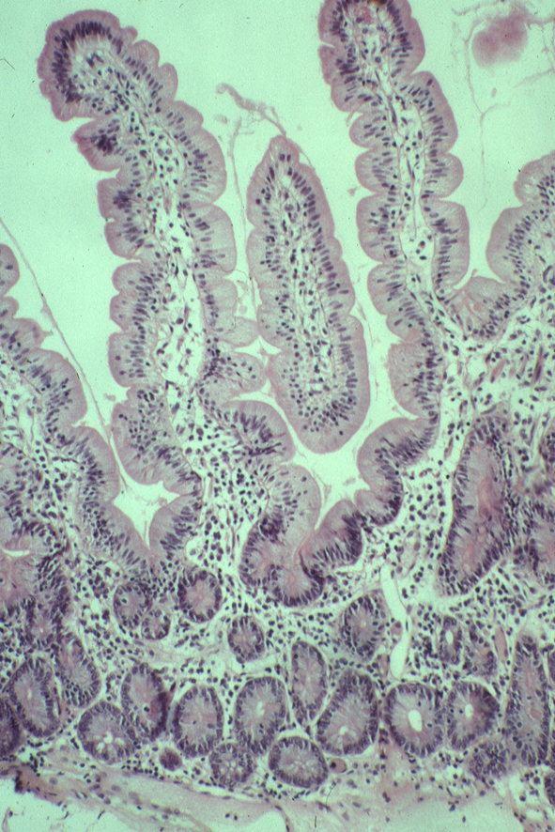
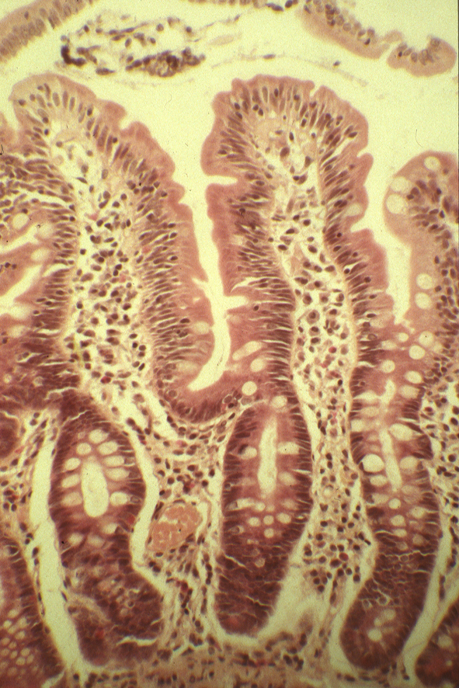
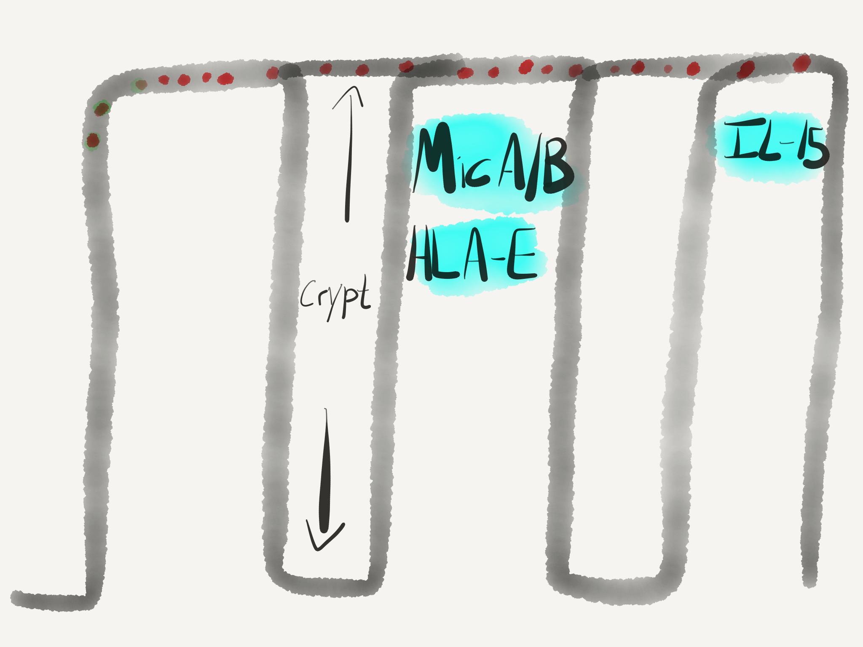
Celiac Disease
Setty M, et. al. Gastroenterology. 2015.
Control
GFD
Active
Notes:
Change the pic for GFD to something better

Slide 6
Methods
Human samples
Paired peripheral blood and duodenal biopsies were obtained from individuals that were then categorized as either Control, Active CD, or Gluten Free CD (GFD) based on serology reports and histological scoring of the duodenal biopsy.
Cell Isolation
Lymphocytes were isolated from peripheral blood (PBL) using ficoll separation, while intraepithelial lymphocytes (IEL) were isolated from duodenal biopsies using mechanical disruption coupled with EDTA.
Various techniques
Analysis for surface marker expression by flow cytometry
Cell sorting
Cell line generation
Ex vivo activation assays
Notes:
Ethylenediaminetetraacetic acid
Chealating agent and sequesters CA
Prevents joining of cadherins between cells

Slide 7
Is the gamma delta T cell compartment in the blood and gut distinct?

Slide 8
TCRɣδ T cells expressing the Vδ1 TCR exhibit tissue specific tropism and phenotype

Slide 9
Does the small intestine select for particular VD1 bearing TCRs?

Slide 10
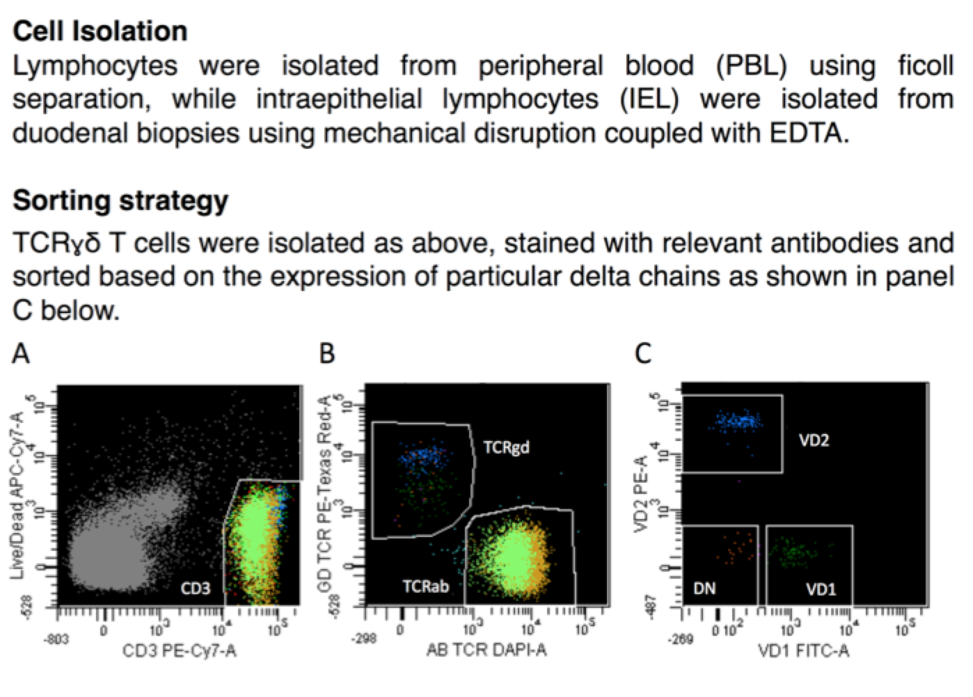
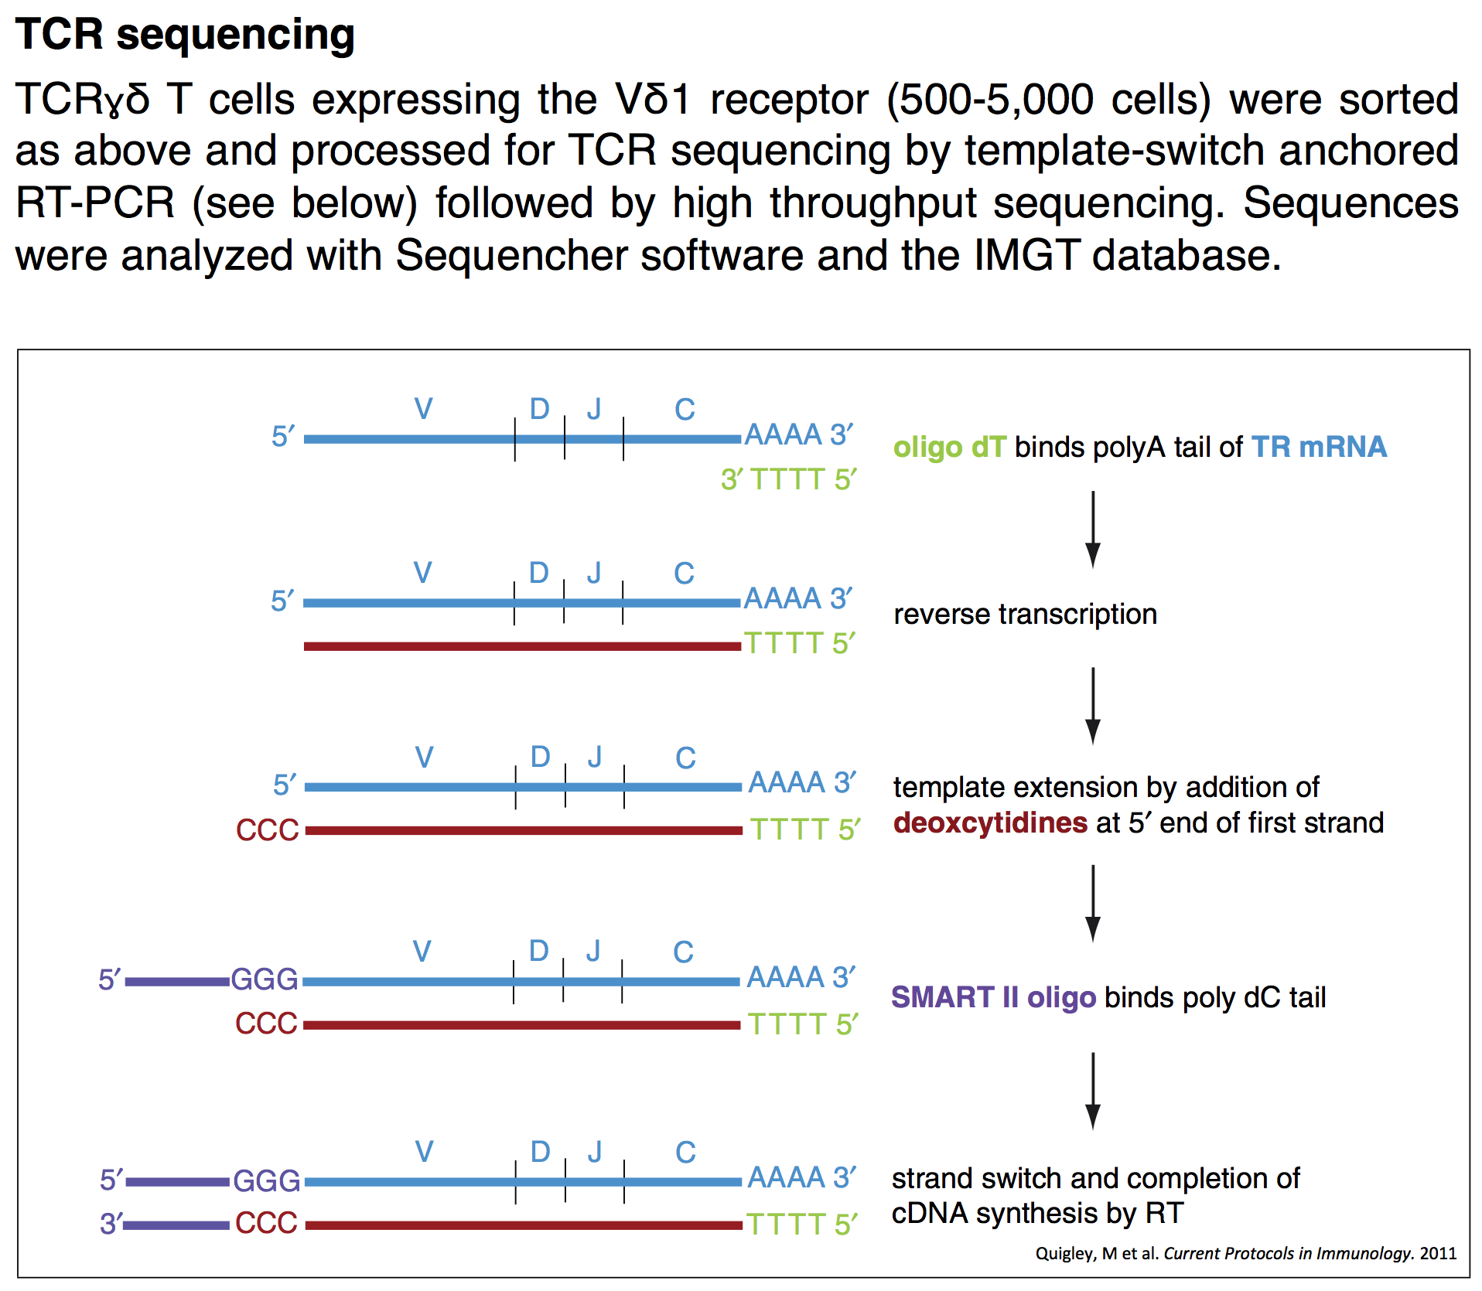
TCR-sequencing
Moloney Murine Leukemia Virus reverse transcriptase
David Price, Kristin Ladell, James McLaren
Notes:
Moloney Murine Leukemia Virus (MMLV) reverse transcriptase

Slide 11
TCRɣδ T cells expressing the Vδ1 TCR exhibit tissue specific Vɣ chain expression in controls

Slide 12
Can perturbations of the small intestinal microenvironment alter the TCR repertoire of TCR Vδ1 T cells?
Control
Active
GFD

Slide 13
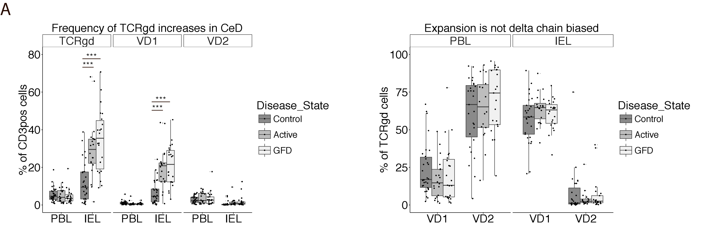
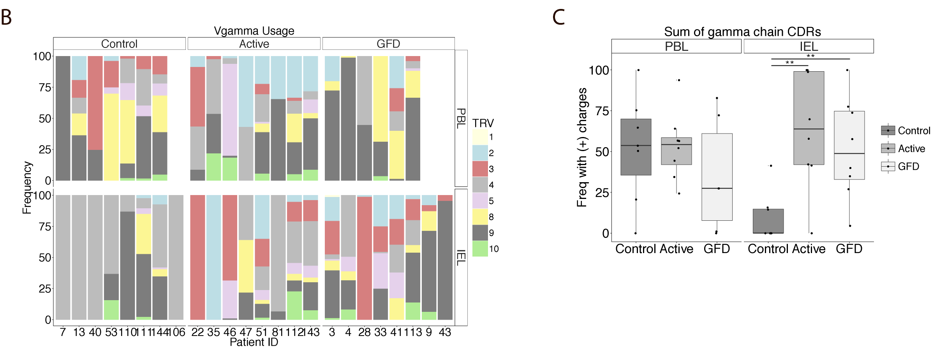
TCRɣδ T cells are expanded in celiac disease and exhibit Vɣ usage permissive for positive charges in CDRs

Slide 14
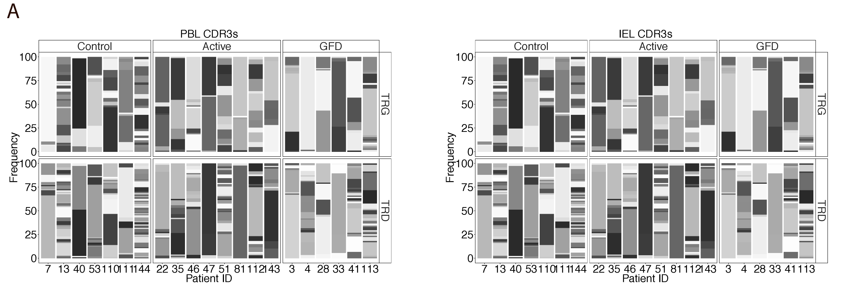
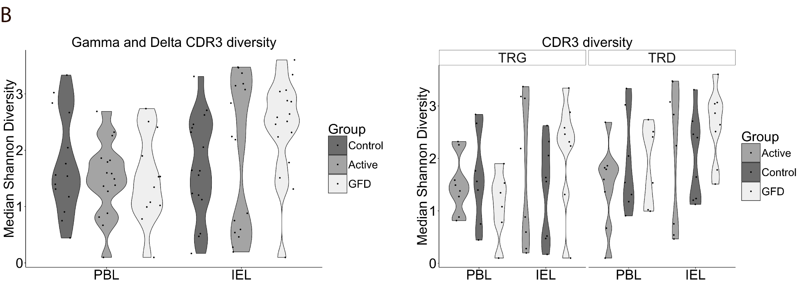
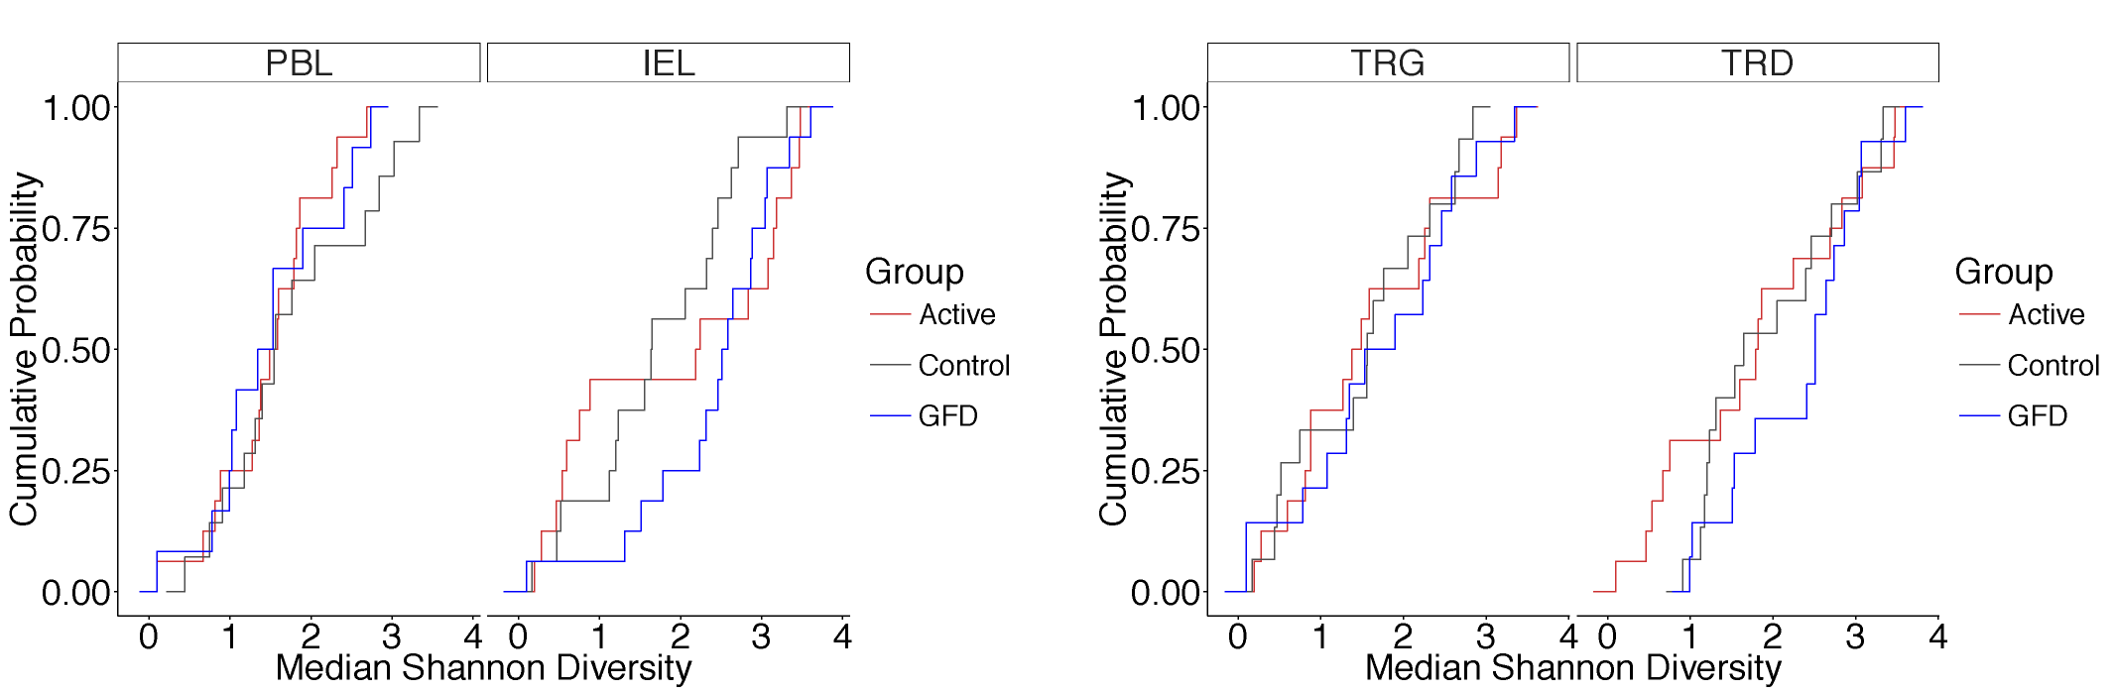
CDR3 diversity reveals two distinct groups of Active celiac

Slide 15
Can the small intestinal microenvironment select for TCR Vδ1 T cells with unique functional capacity?

Slide 16
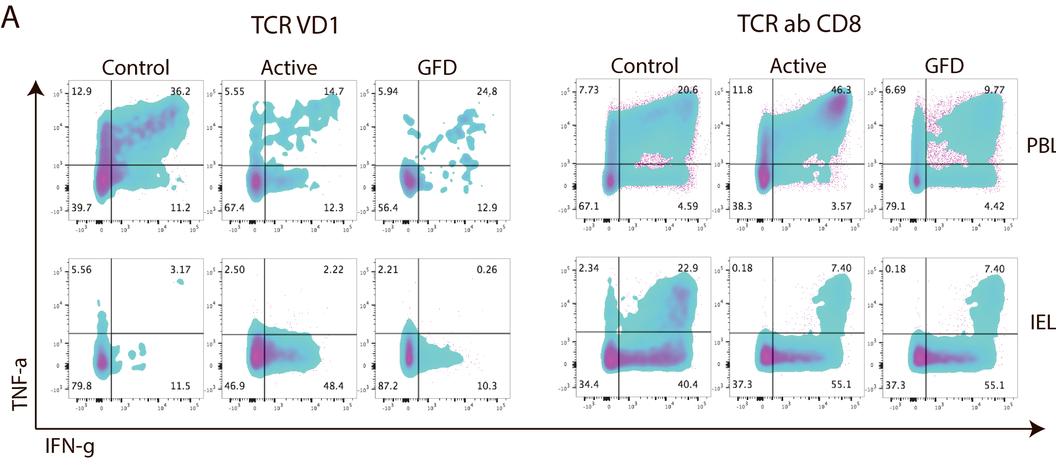
TCRɣδ T cells exhibit a disease state specific cytokine profile in the small intestine
Notes:
> low dose activation suggests there is active engagement
Ionomycin -> calcium
PMA -> PKC activation

Slide 17
TCRɣδ T cells exhibit a disease state specific calcium flux profile in the small intestine

Slide 18
Short term goals
Three months ago:
Further characterize TCR Vδ1
CCR7/CD45RA in Controls, Actives, GFD (used 15 patients to test for differences)
NK receptors (NKG2D, NKG2A, CD94) (used 15 patients to test for differences)
Increasing n numbers in each group for TCR seq data set (added 6 patients to cohort)
What do Vδ1 in Controls do? (used 11 patients and 2 96 well plates of samples to address)
Perform a multi cytokine bioplex assay to proxy for potential cytokine candidates that can be confirmed with flow cytometry
Analysis
Unbiased approach for finding enrichment in CDR3 motifs
Tagging all non-germ line and then clustering based on this
Analyzing the Delta chain CDR3s
Unbiased hierarchical clustering of groups by gamma chain and other factors (freq, NK expression, etc)
Next three months:
Finishing the TCR analysis
Following up on the NK receptor observations
Finishing up the Ca-flux cohort and trying to get anti-CD3 to work
Some form of ex vivo transcriptional profiling

Slide 19
Phenotype with disease?

Slide 20
Phenotype with disease?

Slide 21
Long term questions
Gain insight into how the tissue is changing with disease for leads on potential ligands
I have collected a set of samples sorted on T cell negative cells from biopsies
Also have whole biopsies from patients sequenced for TCR
Active high vs. low diversity
Cloning single TCRs (3 controls, 1 Active, 1 GFD)
Control
Patient | Delta 1 | Gamma 4
88 | CALGELGPTRGYWGANFTDKLIF | CALGELGPTRGYWGANFTDKLIF
94 | CALGELRTYSVLGKLIF | CATWDVYYKKLF
95 | CALGELGKLIF | CATWDGQYKKLF

Slide 22
Acknowledgments
Jabri Lab
Bana Jabri
Cezary Ciszewski
Kathryn Lesko
Ian Lawrence
Jagoda Rokicka
Hoda Sayegh
R01 DK067180
Physicians
Stefano Guandalini
Sonia Kupfer
Carol Semrad
Price Lab
David Price
Kristin Ladell
James McLaren
Dinner Lab
Aaron Dinner
Herman Gudjonson
Immunology Training Grant

Slide 23
Extra slides in case of questions

Slide 24



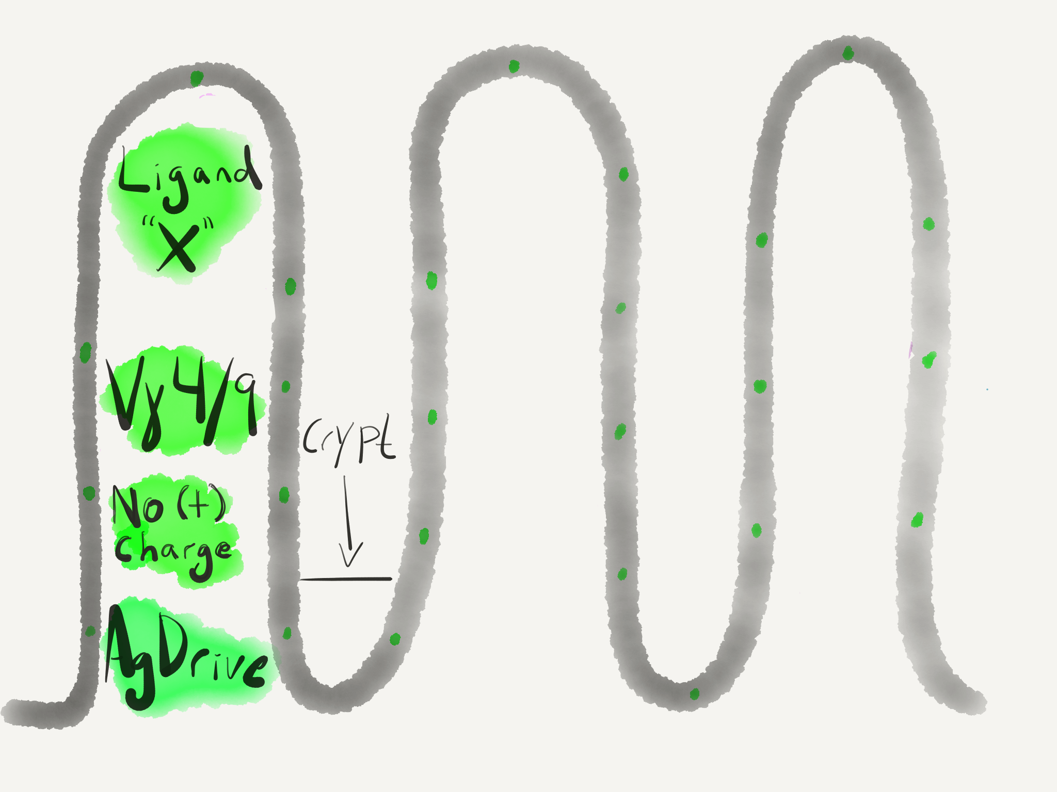
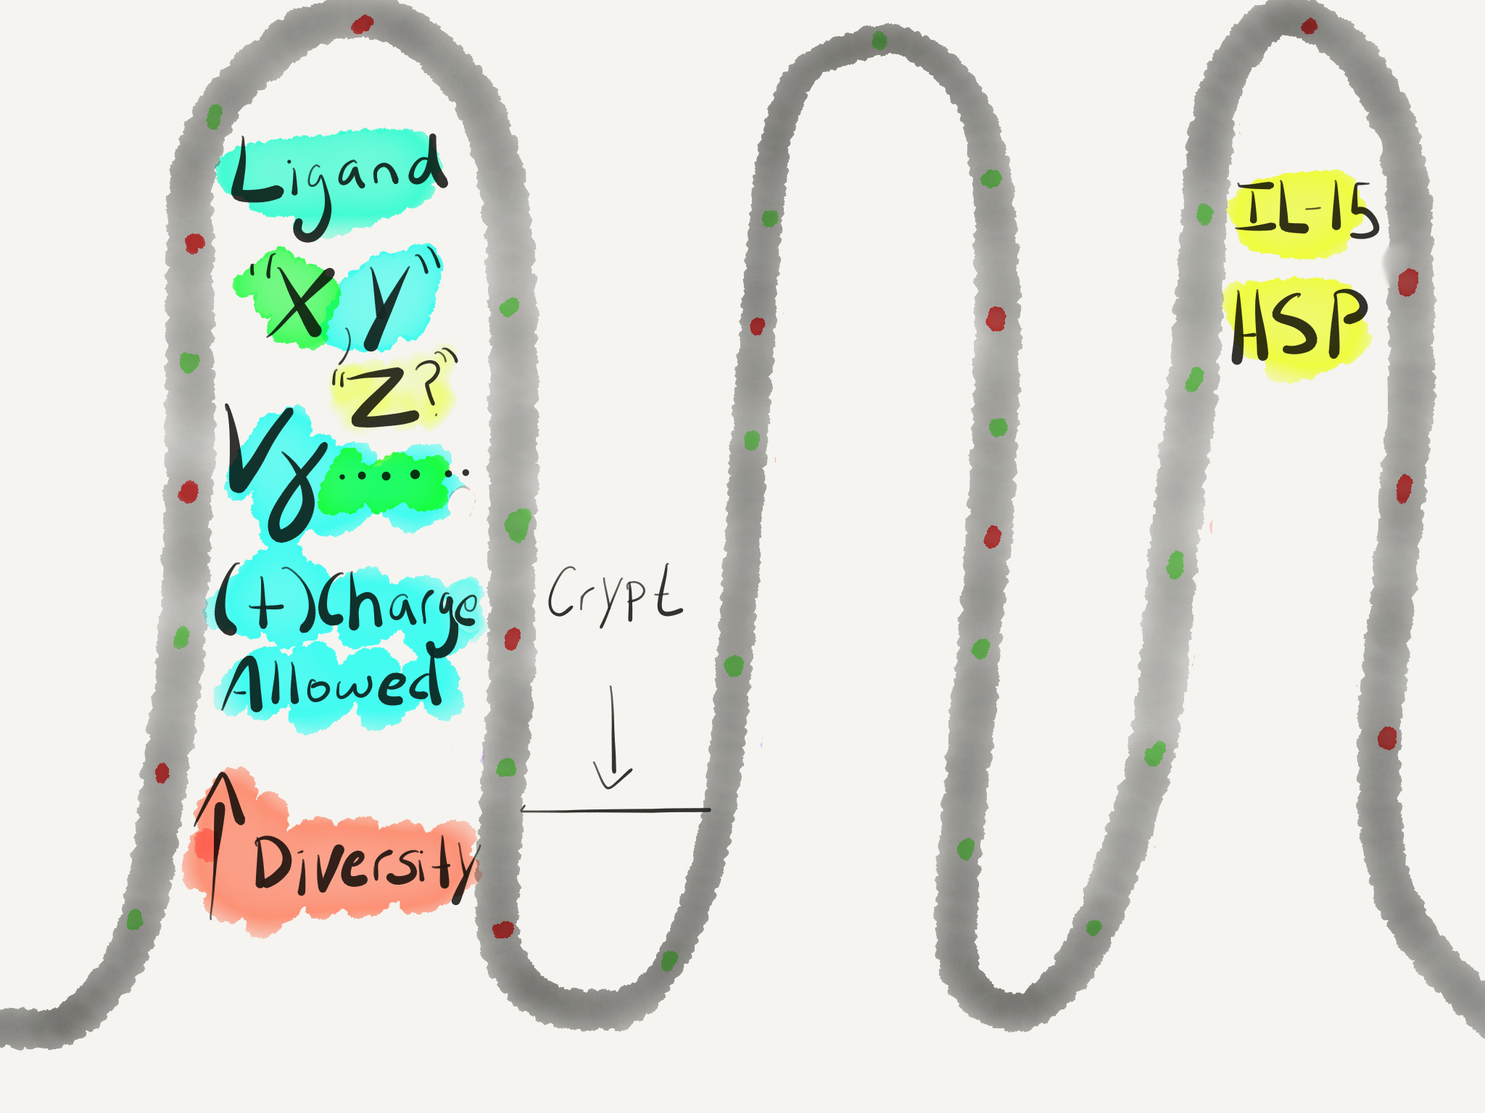


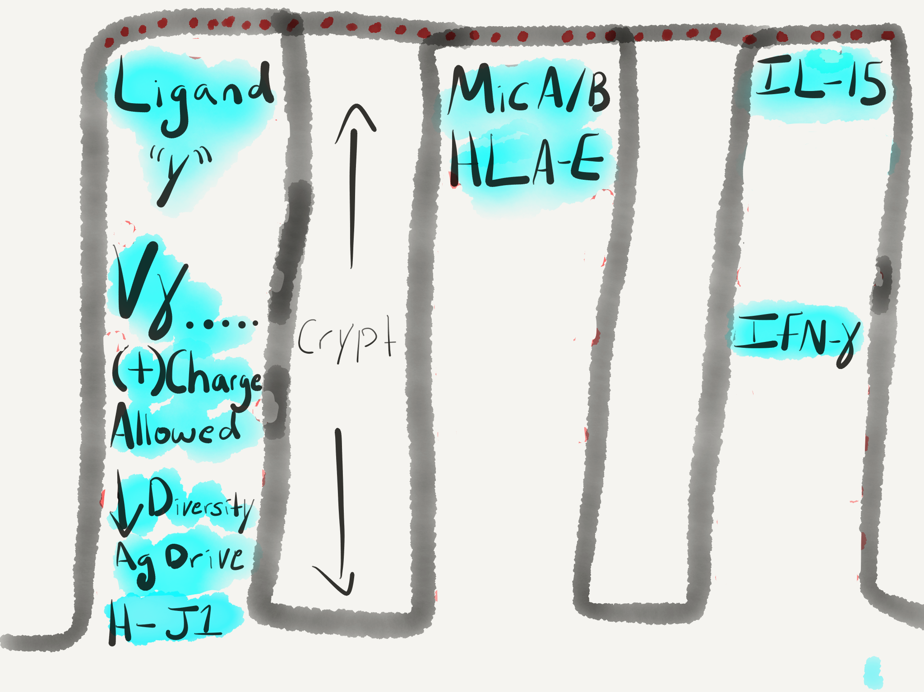
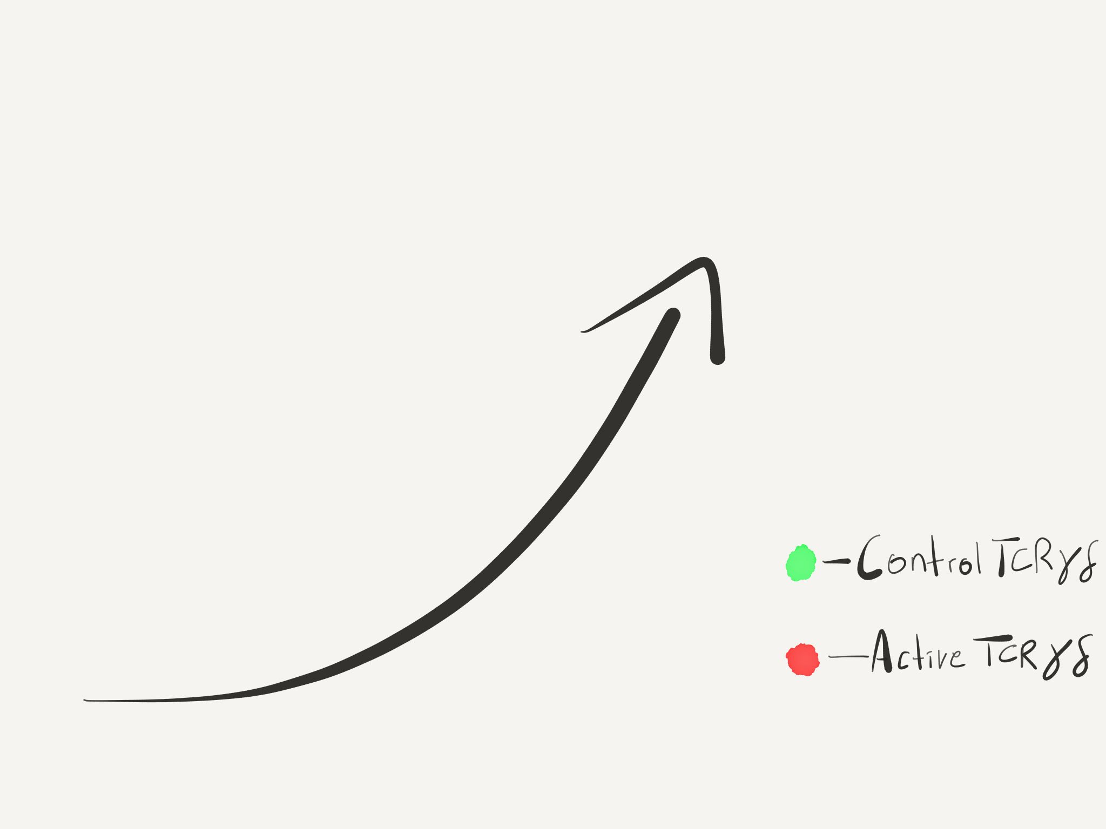
?

Slide 25
Is the reduced diversity in the gamma chain of Actives antigen driven?
Notes:
I have to make the comment that we have to keep in mind there is an expansion of cells in actives so seeing a reduction in diversity compared to controls coupled with antigen drive would indicate it’s a TCR driven event

Slide 26
Patient | Freq | TRGV | CDR3 (AA_NT) | TRGJ
35 | (84/87) | 2 | C A T W D G P A G D W I K T F | P2
 |  |  | tgt gcc acc tgg gac ggg ccg gcg ggt gat tgg atc aag acg ttt
 |  |  | tgc gcc acc tgg gac ggg ccg gcg ggt gat tgg atc aag acg ttt
 | (1/87) | 2 | C A T W G G P A G D W I K T F | P2
 |  |  | tgt gcc acc tgg ggc ggg ccg gcg ggt gat tgg atc aag acg ttt
46 | (60/92) | 3 | C A T W D G W R H K K L F | 1
 |  |  | tgt gcc acc tgg gac gga tgg agg cat aag aaa ctc ttt
 | (1/92) | 3 | C A T W D G W G H K K L F | 1
 |  |  | tgt gcc acc tgg gac gga tgg ggg cat aag aaa ctc ttt
 | (1/92) | 3 | C A T W G G W R H K K L F | 1
 |  |  | tgt gcc acc tgg ggc gga tgg agg cat aag aaa ctc ttt
 | (1/92) | 3 | C A T R D G R R H K K L F | 1
 |  |  | tgt gcc acc cgg gac gga cgg agg cat aag aaa ctc ttt
 | (26/92) | 5 | C A T W T P Y P P L M G K L F | 1
 |  |  | tgt gcc acc tgg acc ccg tat ccc ccc cta atg ggg aaa ctc ttt
 | (1/92) | 5 | C A P W T P Y P P L M G K F F | 1
 |  |  | tgt gcc ccc tgg acc ccg tat ccc ccc cta atg ggg aaa ttc ttt
 | (1/92) | 5 | C A T W T P H P P L M G K L F | 1
 |  |  | tgt gcc acc tgg acc ccg cat ccc ccc cta atg ggg aaa ctc ttt
47 | (18/64) | 4 | C A T W S H Y Y K K L F | 1
 |  |  | tgt gcc acc tgg tcc cac tat tat aag aaa ctc ttt
 | (1/64) |  | C A T G S H Y Y K K L F
 |  |  | tgt gcc acc ggg tcc cat tat tat aag aaa ctc ttt
 | (9/64) | 8 | C A T W D N Y K K L F | 1 or 2
 |  |  | tgt gcc acc tgg gat aac tat aag aaa ctc ttt
 |  |  | tgt gcc acc tgg gat aac tat aag aag ctc ttt
81 | (82/89) | 4 | C A T W D H Y K K L F | 1 or 2
 |  |  | tgt gcc acc tgg gat cat tat aag aaa ctc ttt
 | (1/89) | 4 | C A T T D H Y K K L F | 1
 |  |  | tgt gcc aca acg gat cat tat aag aaa ctc ttt
 | (6/89) | 9 | C A L W E V R Y K K L F | 1 or 2
 |  |  | tgt gcc ttg tgg gag gtg cga tat aag aaa ctc ttt
 |  |  | tgt gcc ttg tgg gag gtg cga tat aag aag ctc ttt

Slide 27
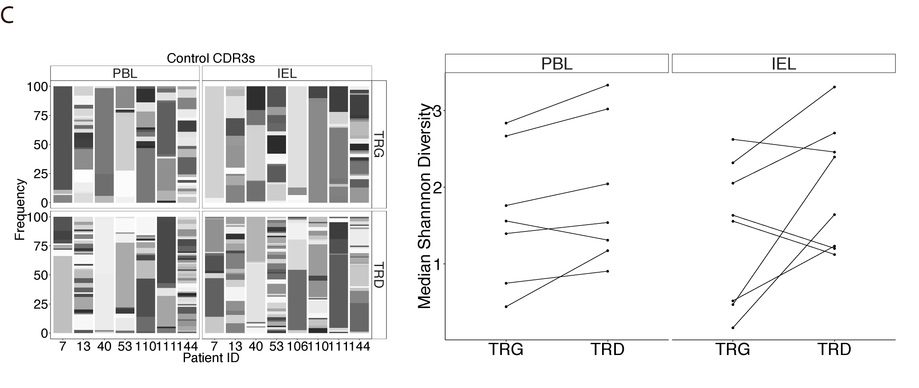
Unique gamma to delta pairing behavior in the small intestine of controls
Notes:
Could be allelic exclusion of the delta is poor so you have multiple deltas being made for same cell to pair with a single gamma. Difficulty here is why would this happen in the intestine preferentially?
We would have to do single cell sequencing to get that.
Second scenario is that the gamma chain is being selected for in the intestine and the delta is less important at the level of the CDR3 so a mixture of deltas come down with the same gamma.
In addition I can state we don’t have overlap between the blood and gut for delta or gamma in controls and no overlap between gammas in controls.

Slide 28
Ligands
Vantourout P and Hayday A. Nature Reviews Immunology. 2013
Born K, et al. Cellular & Molecular Immunology
Notes:
Endothelial protein C receptor

Slide 29
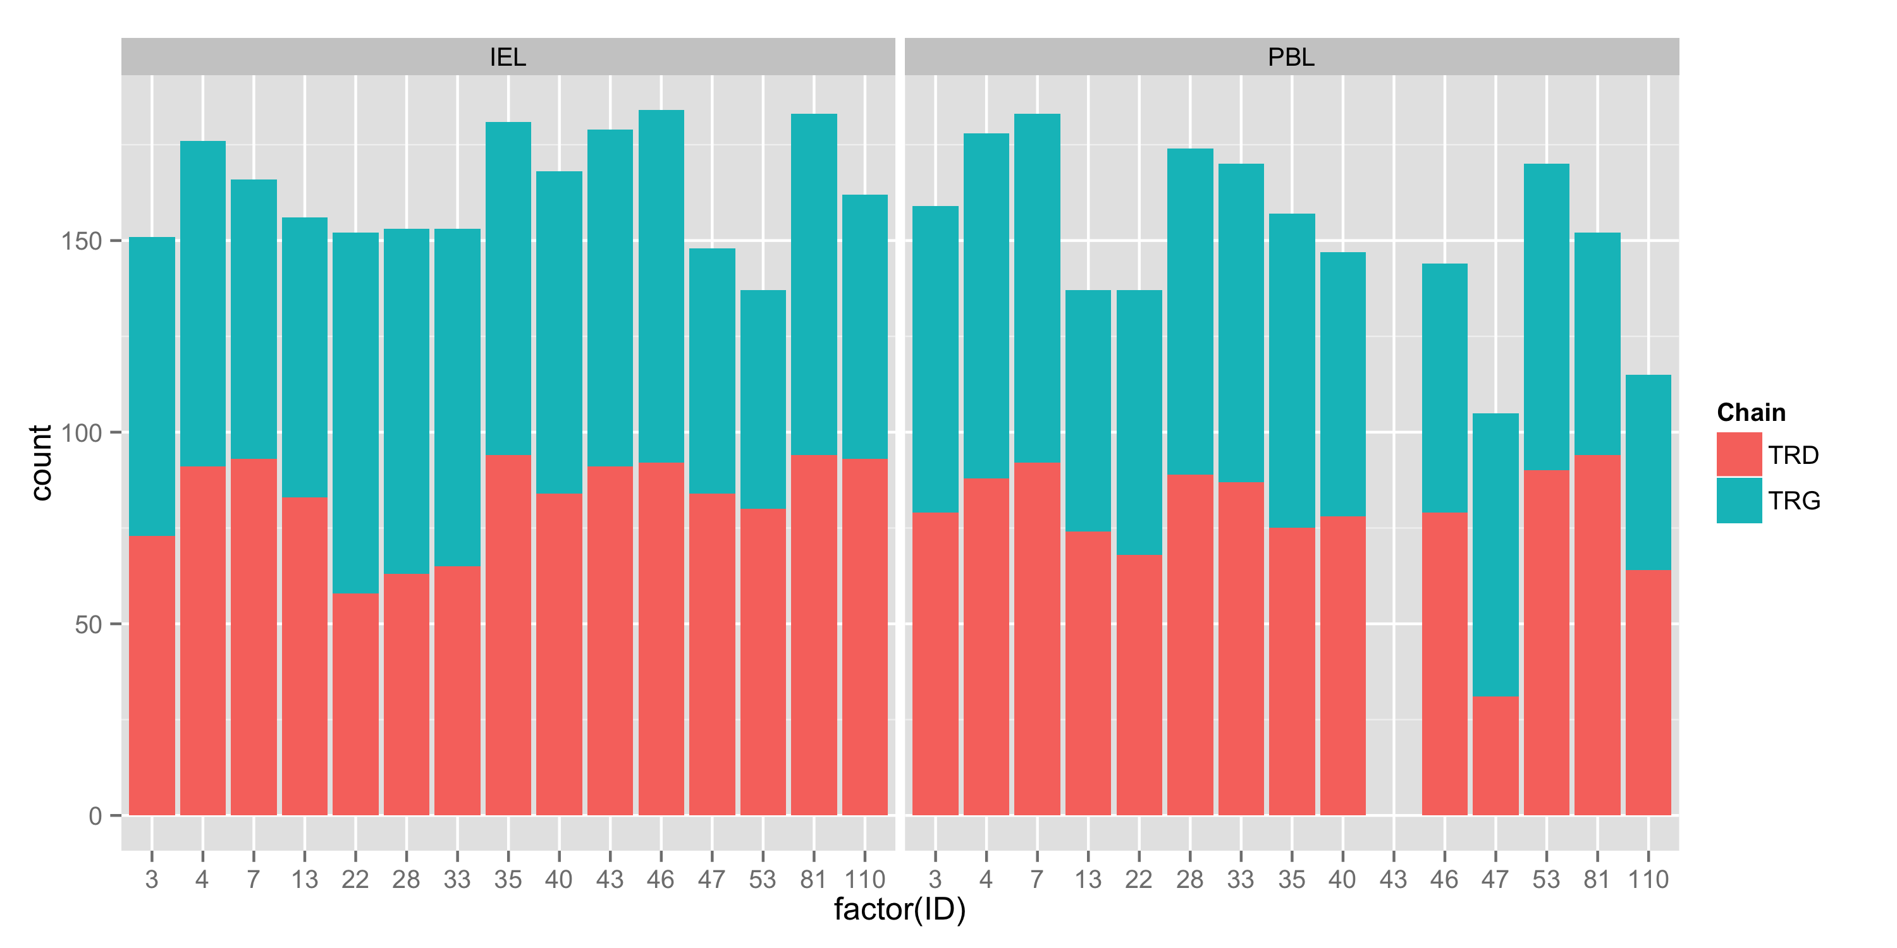
Transcripts sequenced per sample

Slide 30
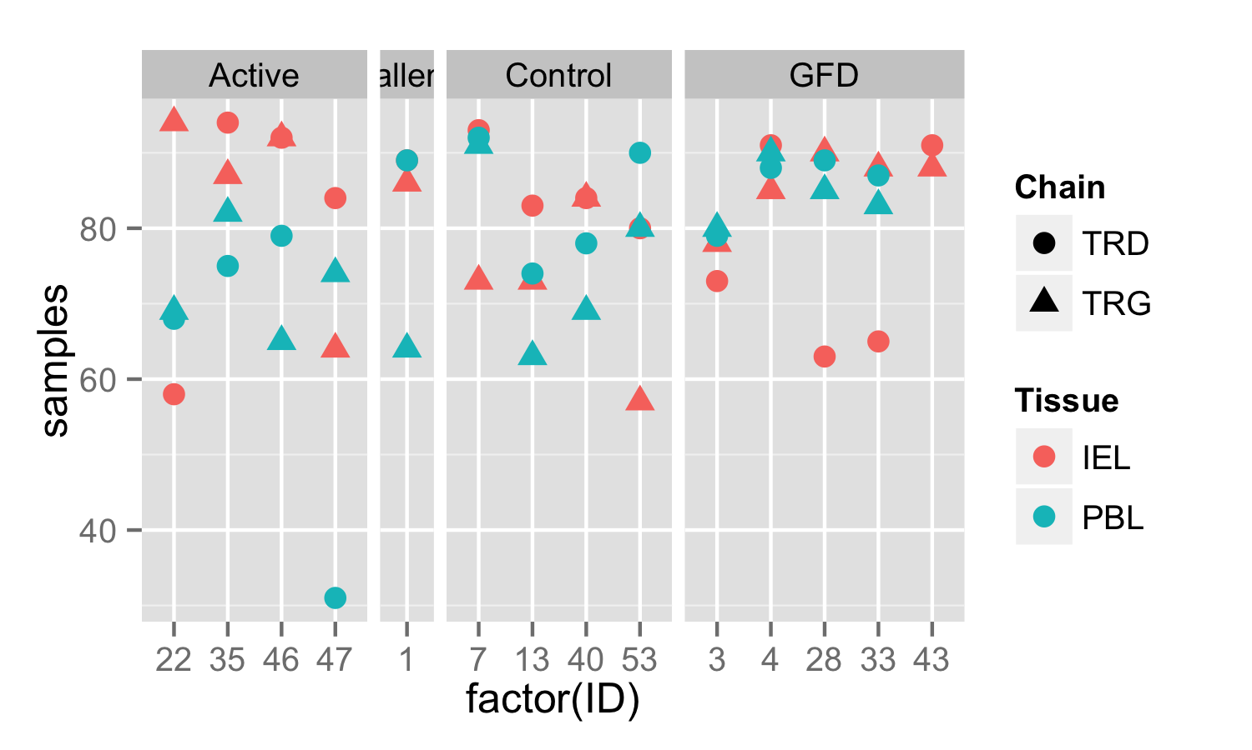
Diversity measurements accounting for sample sizes
I subsampled to 50 to normalize

Slide 31
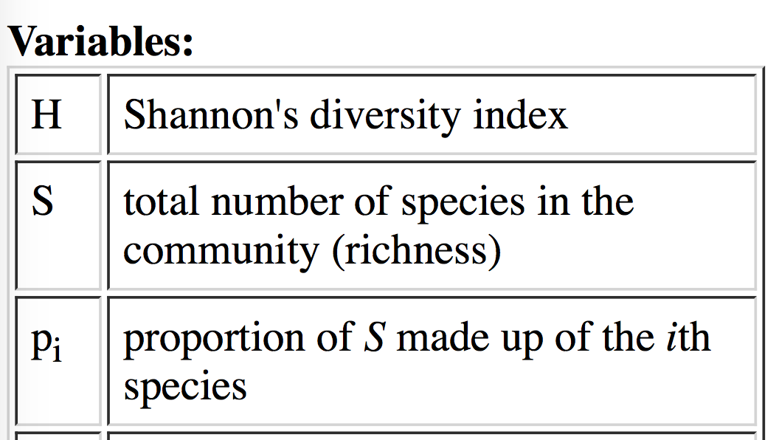
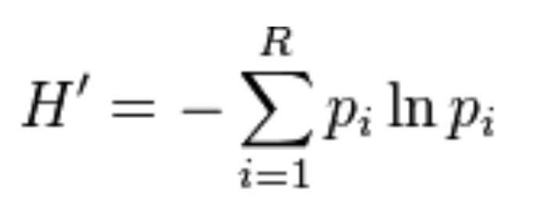
Shannon diversity index

Slide 32
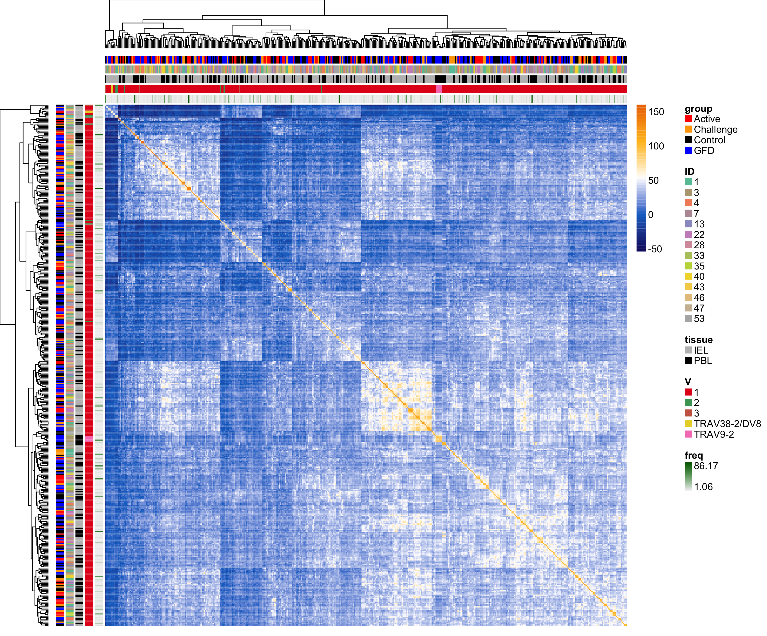
Pairwise CDR3 Sequence Similarity (BLOSUM62)
TRD

Slide 33
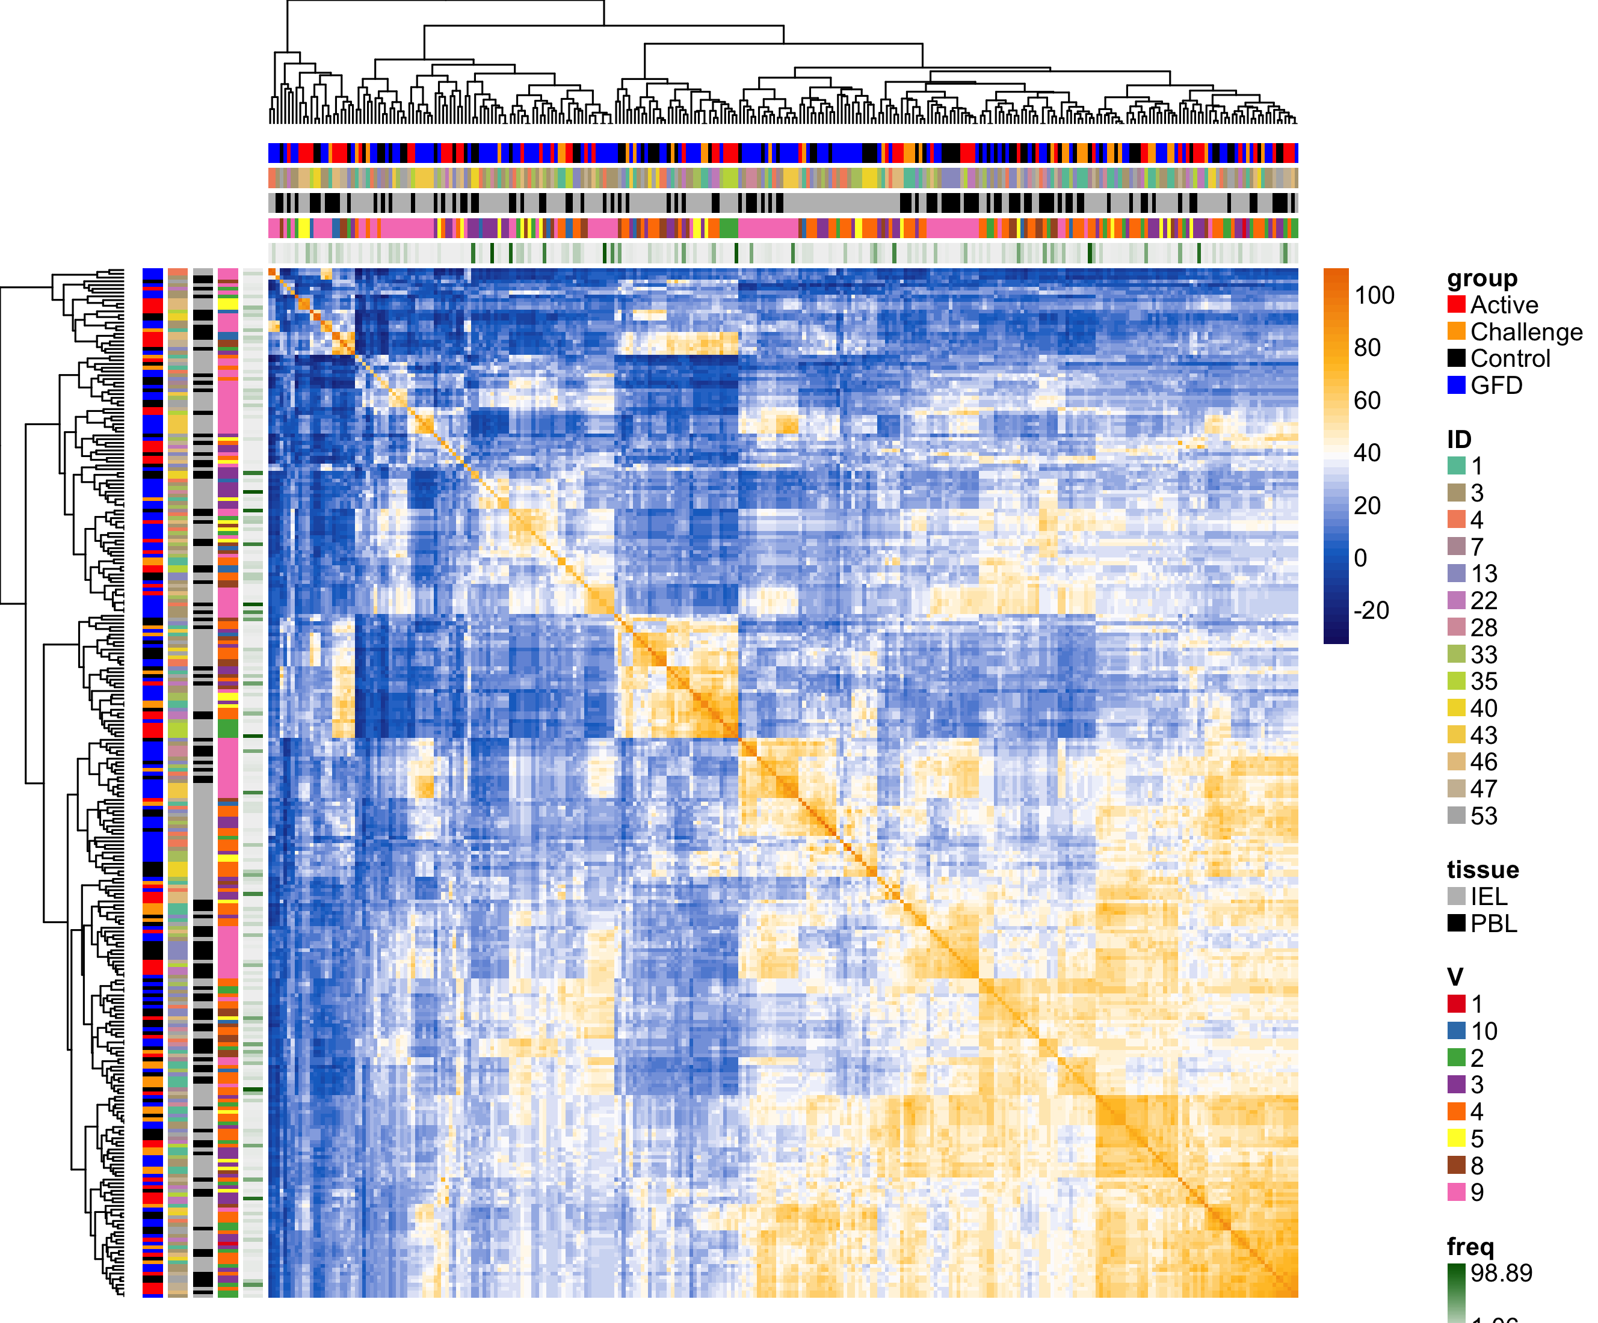
Pairwise CDR3 Sequence Similarity (BLOSUM62)
TRG

Slide 34
Cluster A
TRD
Cluster B
A
B
Cluster C
C

Slide 35
Cluster A
Cluster B
TRG
A
Cluster C
B
C
Cluster D
D

Slide 36
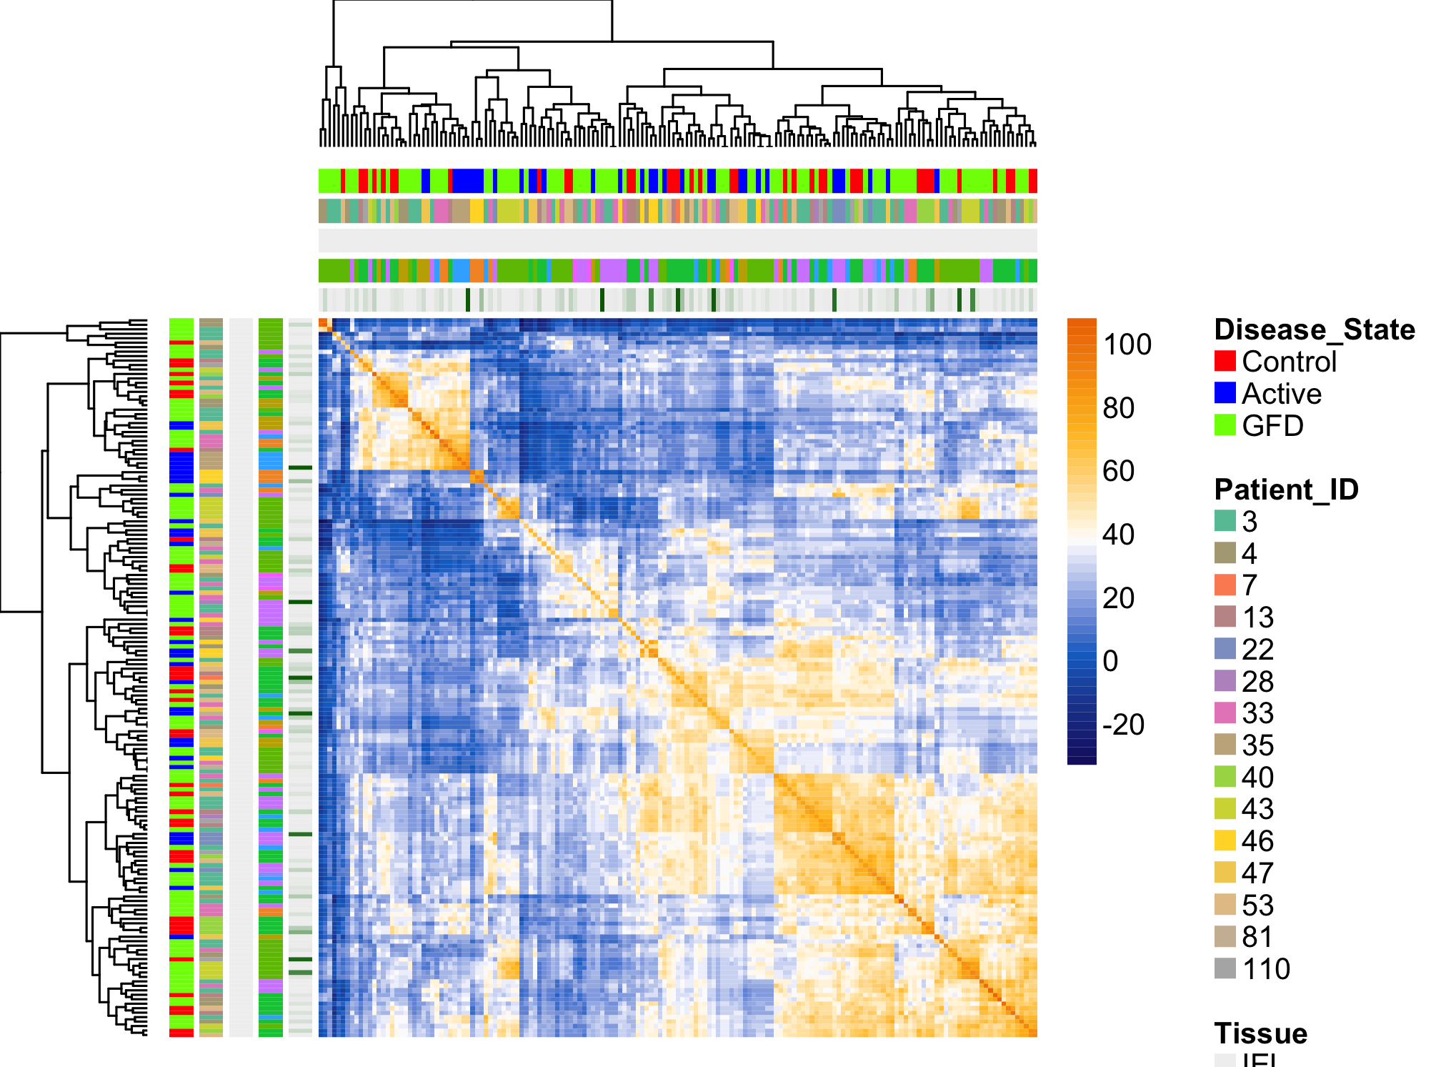

Slide 37
